Slide 1
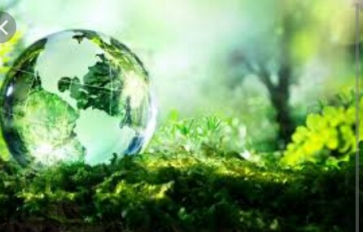

Ecology

Slide 2
Ecology is the branch of biology which studies the interactions among organisms and their environment.Objects of study include interactions of organisms with each other and whith abiotic components of their environment.Topics of interest include the biodiversity, distribution,biomass and populations of organisms as well as cooperation and competition with in and between species.

Slide 3
The word “ Ecology” was coined in 1866 by the German scientist Ernest Haeckel. Ecological thought is derivative of established currents in philosophy , particularly from ethics and politics. Ancient Greek philosphers such as Hippocrates and Aristotle laid the foundations of ecology in their studies on natural history. Modern ecology became a much more rigorous science in the late 19 th century. Evolutionary concepts relating to adaptation and natural selection became the cornerstones of modern ecological theory.

Slide 4
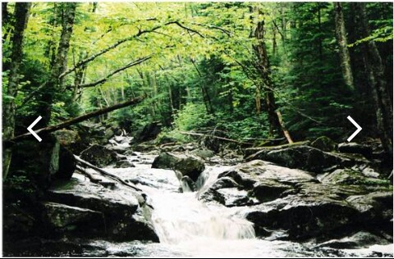
Many ecologists consider that the disappearance of particular living species constitutes the main ecological and social problems of today. The world’s famous biologists warn that the present situation is fraught whith extinction of animals and plants on a scale much greater than their both natural and man caused extinction during the preceding millions of years.

Slide 5
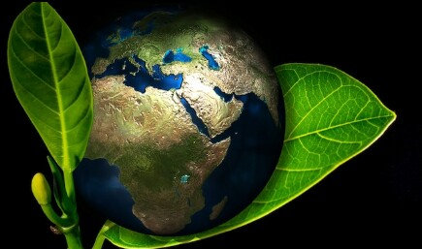

The problem of “ Man and biospere” can and must be solved by the efforts of all countries.
Cooperation , long-term coordinated devolopment
plans for all countries , or joint solution of global problems are possible only in the conditions of peace.

Slide 6
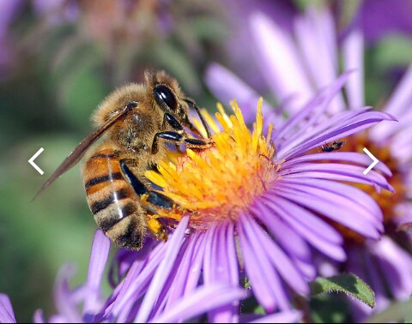
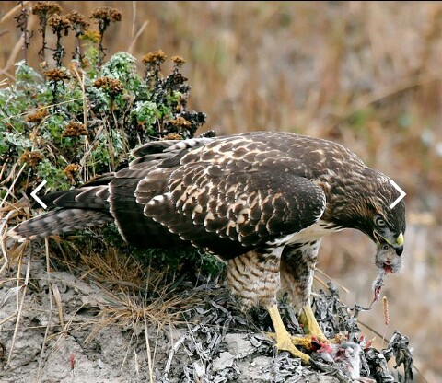
We often forget that the component parts of the earth environment are parts of a larger whole , interrelated with each other in a variety of ways.
Thus, we have geologists, hydrologists, climatologists, biologists and each group is concerned with certain specific parts of the environmental interactions between regions.

Slide 7
The end.

